Slide 1
For you

Slide 2

Barrier
Mobile news app users say they want personalized content, but few have taken steps to get it.
Mobile News Apps Survey Results, June 2017
Notes:
What could attract their focus?

Slide 3
Ideal perception
For you=Content relevant to me

Slide 4
Design direction
How to make users know or feel the content are relevant to them?

Slide 5
Awareness
Action
Engagement
Evaluation

Slide 6
Awareness
Action
Engagement
Evaluation

Slide 7
1Awareness
HMW make first time knowing that the content on opal is personalize

Slide 8
Intention
Users have had their target topics(existed in their mind) to follow

Slide 9
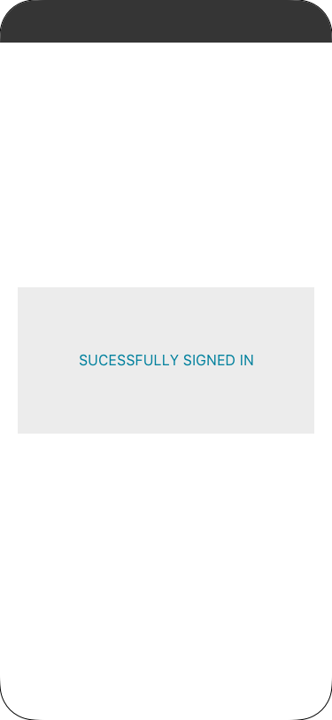
1Awareness
Starting point: After users first time signed in

Slide 10
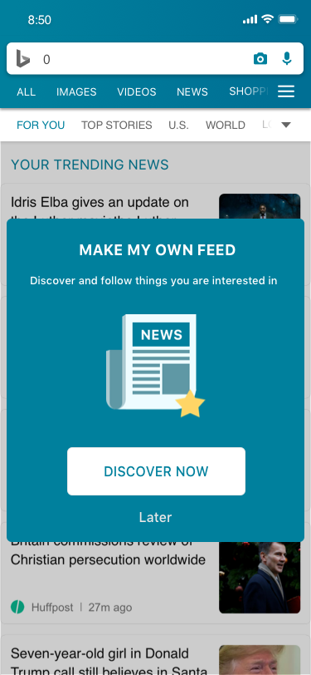
1Awareness
A pop up to let them know they could get personalized content

Slide 11
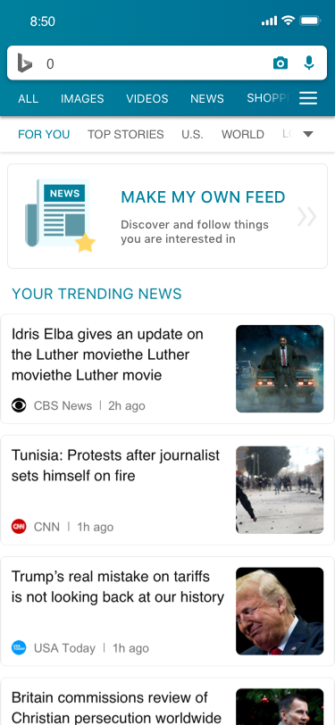
1Awareness
Later entry point for no intention to do now

Slide 12
Content personalization

Slide 13
Awareness
Action
Engagement
Evaluation

Slide 14
2Action
HMW make a more accessible and visible follow function when uses intent to follow topics

Slide 15
Expectation
People want easier, more immediate ways to personalize their feed to make it more useful and engaging.
Mobile News Apps Survey Results, June 2017
Notes:
What could attract their focus?

Slide 16
2Action
Existed
Search result
Comprehensive page-more news
Proposed
First time personalization pop up
Comprehensive view page improvement

Slide 17
Intention
Users have had their target topics(existed in their mind) to follow

Slide 18
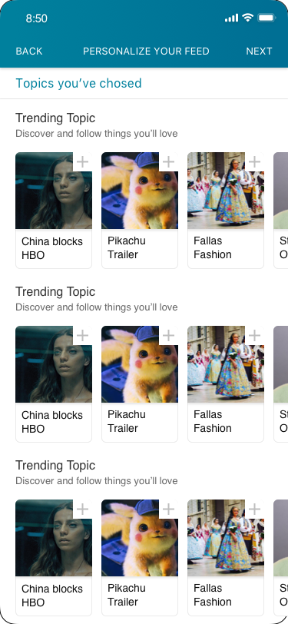
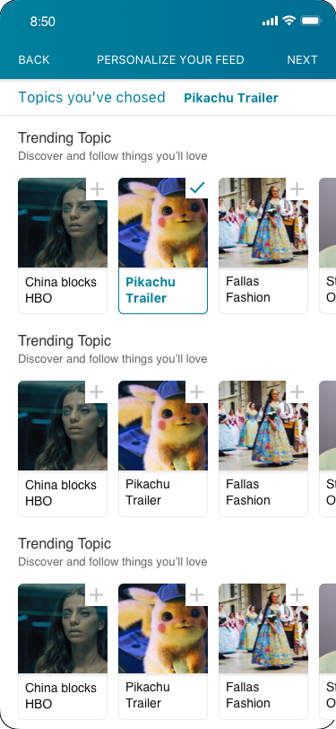
2Action
Content personalization page

Slide 19
Intention
Users have desire to follow a topic when they are reading it in-detailed

Slide 20
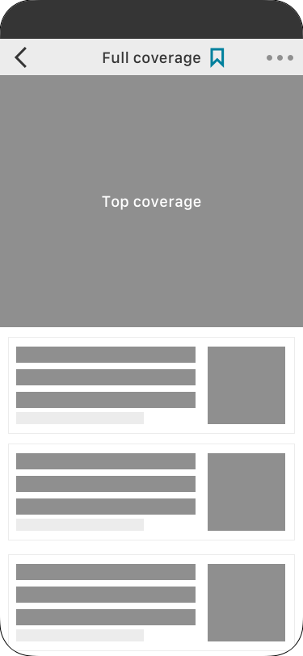
2Action
Fix follow button

Slide 21
Awareness
Action
Engagement
Evaluation

Slide 22
3Engagement
HMW make the for you tab feel more relevant to you

Slide 23
Expectation
Users prefer content to be organized by category/topic.
Mobile News Apps Survey Results, June 2017
Notes:
What could attract their focus?

Slide 24
3Engagement
Design direction
Make users see the topics they followed clearly

Slide 25
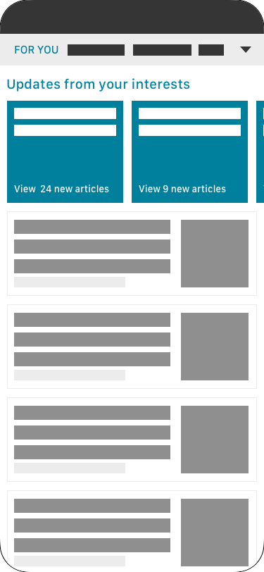
3Engagement
3-1Updates

Slide 26
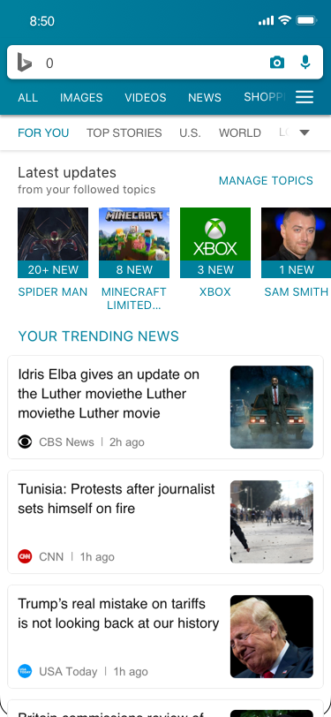
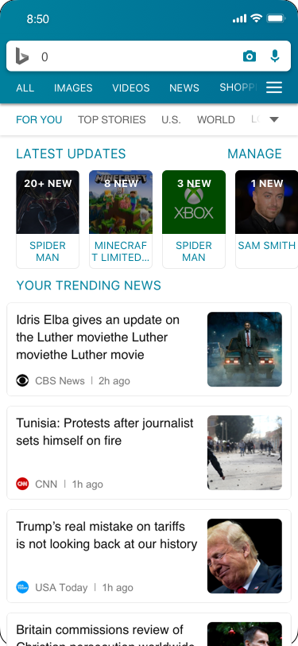
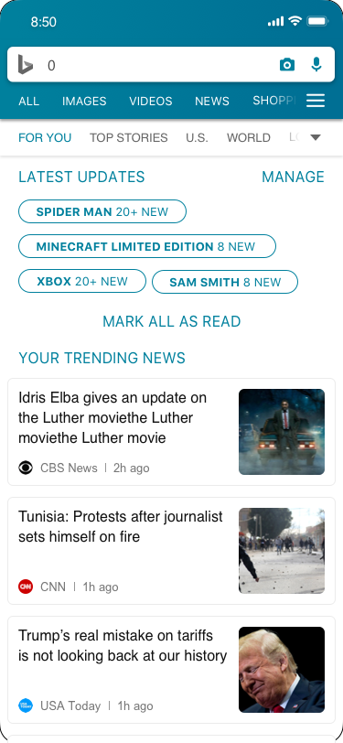
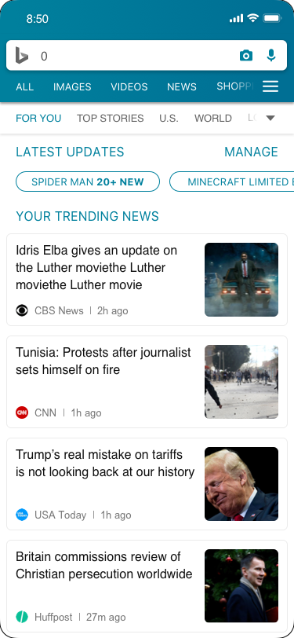
Design 1
Design 2
Design 3
Design 4

Slide 27
Awareness
Action
Engagement
Evaluation

Slide 28
4Evaluation
HMW make a more

Slide 29
Intention
Unfollow not preferable topics to make content of for you more relevant
Explore new topics

Slide 30
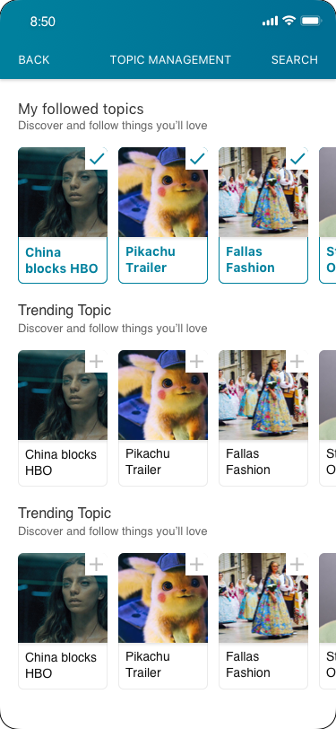
4Evaluation
Manage page

